Slide 1
Responsive Design
Week 8

Slide 2
State of the Internet
Nearly 3.5 billion people have access to the internet today
Internet is accessible from all kinds of devices including:
Laptops and Desktops
Tablets
Smartphones
Game consoles
Smartwatches
Fridges
Microwaves
We are in the post-PC era!

Slide 3
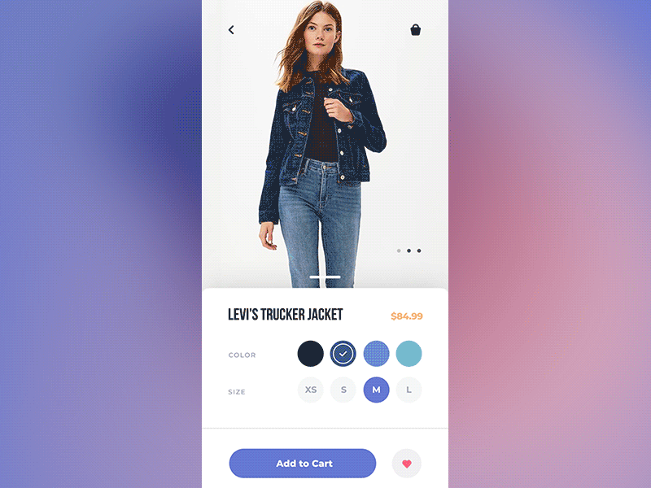

Slide 4
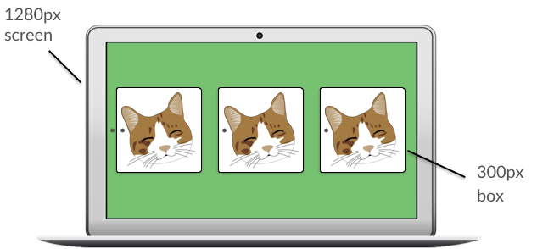
Why won’t my site work on all devices?
1280px screen
300px box

Slide 5
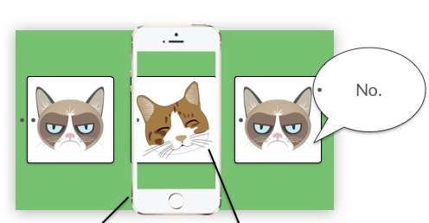
Why won’t my site work on all devices?
300px screen
300px box

Slide 6
Inspector Demo — What does my site look like on mobile, anyway?

Slide 7
Why won’t my site work on all devices?
Different devices come with different screen sizes and rendering engines
Content designed for a laptop with a much bigger screen won’t look the same on a tablet/mobile with a much smaller screen

Slide 8
What does this mean for designers?

Slide 9
We need to make sure our websites work on all devices & browsers

Slide 10
Responsive Web Design
“Designing websites for multiple screen sizes and devices, so that there is an optimal experience for every user at every possible size.”
Responsive design deals with:
Browser compatibility
Screen resolutions
Mobile compatibility
We will be exploring each of these aspects today

Slide 11
Issue 1: Browser Compatibility

Slide 12
Browser Compatibility
The ability of a website to function “as expected” on any web browser (including IE)
Browsers have different rendering engines, which is the component that displays the HTML and CSS onto the screen
As a result, each browser interprets your code differently

Slide 13
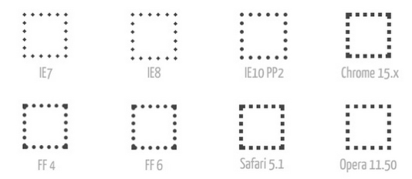
Dotted Border Differences

Slide 14
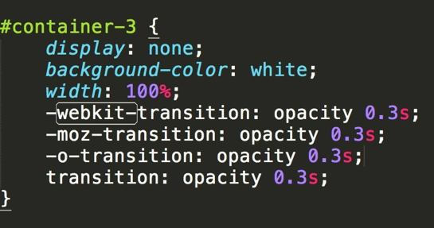
Vendor Prefixes

Slide 15
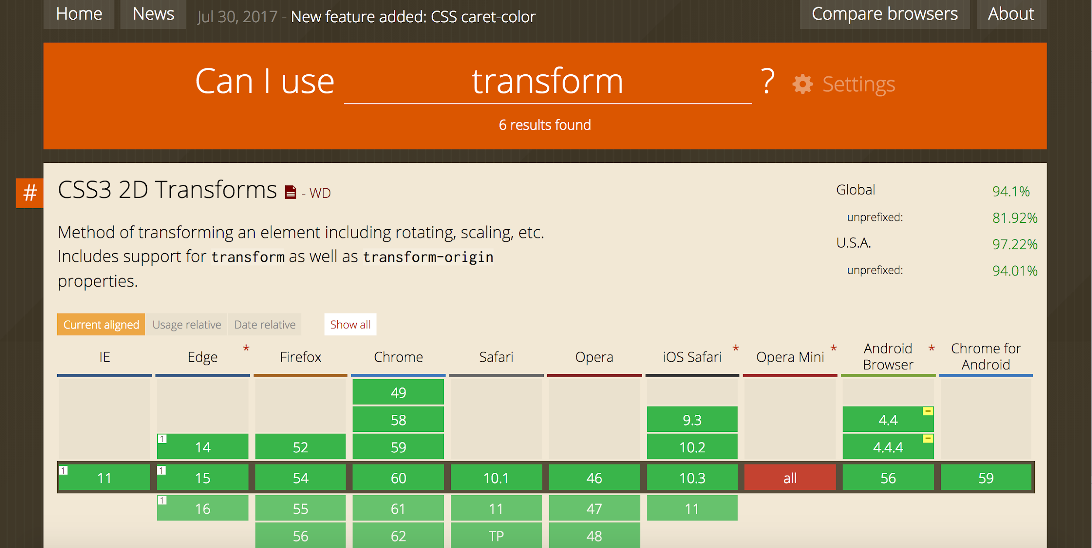
caniuse.com— Great resource!

Slide 16
Vendor Prefixes — Limitations
Commonly use vendor prefixes for simple things (linear gradients, transitions, etc.)
Instead of vendor prefixes, major browsers are moving away from prefixes and toward @supports or feature queries.
Not really in the scope of this class, but feel free to research on your own!

Slide 17
Issue 2: Screen Resolutions

Slide 18
Screen Res, y’all
Resolution: how many pixels your screen can display horizontally and vertically
whatismyscreenresolution.com
Not all users will view your website on devices with the same screen resolution
13” Macbook Pro vs 15” Macbook Pro
Changing the size of your browser window also affects how your website looks

Slide 19
Screen Res, y’all
Use containers to make your content fit a certain size
Using a container size of ~1024x768 is ideal:
All screen resolutions greater than or equal the size of the container will have a good viewing experience

Slide 20
Lower Screen Resolutions:
Use CSS Media Queries

Slide 21
Issue 3: Mobile Compatibility

Slide 22
Designing for Mobile
User interfaces for mobile websites are quite different than those for desktop
They differ in three main ways:
Screen size
Touchscreen capabilities
Performance

Slide 23
Mobile vs Desktop
 | Mobile | Desktop
Screen Size | 3.5” - 5.5” | 11” - 30”
Input Method | Touchscreen | Mouse/trackpad
Performance | Relatively slow | Relatively fast

Slide 24
Screen Size
Screen size is much, much smaller than on desktop:
Focus on the content and tuck everything else away
Due to the restricted space, most UIs should stack elements vertically
Helps maximize the width and emphasis on each element

Slide 25

Restrict your use of position: fixed elements
They reduce space for content
Top bar and ad at the bottom are fixed, leaving less space for content

Slide 26
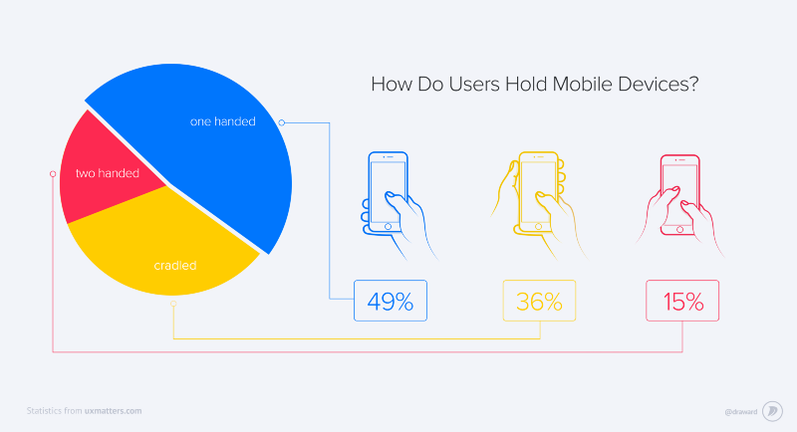
We mostly use our mobile phones one-handed

Slide 27
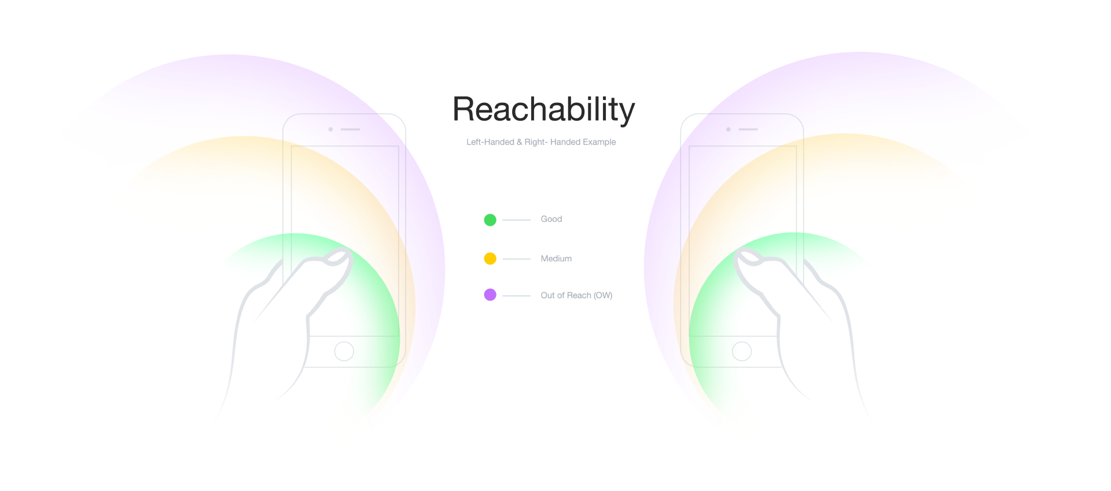
Reachability has physical limits

Slide 28
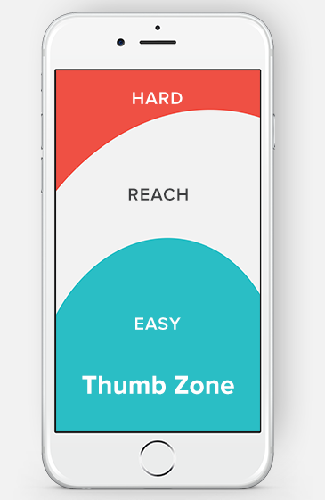
Touch Screen
Thumbs are less precise than cursors
Add padding to accommodate for the size of people’s thumbs
Commonly used buttons should be placed at the bottom of the screen: Improves reachability

Slide 29
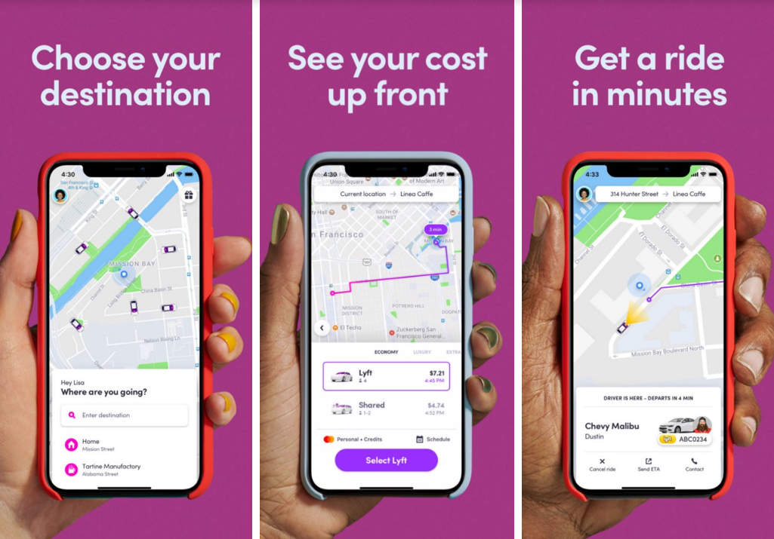
Lyft — Effective mobile reachability

Slide 30
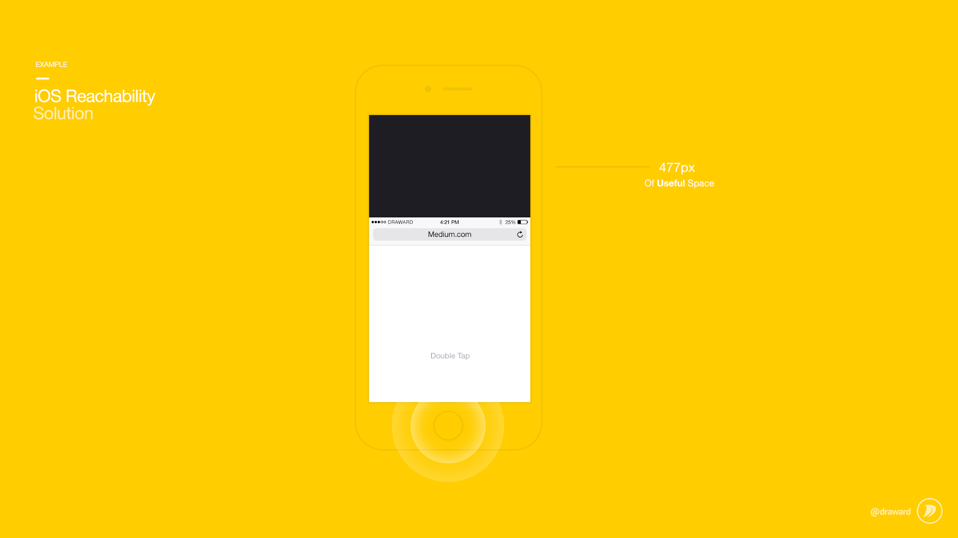
iOS Human Interface Guidelines Reachability Solution (2014)

Slide 31
Performance
Rendering performance on mobile is roughly half that of desktop
This causes mobile websites to be slow
Minimize heavy JavaScript front-end manipulation
Minimize use of transitions, animations, hover effects, etc.
Mobile UIs should be as simple as “click and scroll”

Slide 32
Solution: Mobile-First Design

Slide 33
Performance
It’s harder to squash things down fit more things in smaller space than opening things up and adding more things to fill a larger space
Design for mobile first, then design for larger screens
forces you think about what is important (visual hierarchy!)
Convention != Quality
Remember Lyft vs Uber and Apple HIG

Slide 34
Review
Designing for variation is important
Make sure your websites work on all browsers
Add prefixes if necessary
Make sure your websites work WELL on all devices
Use media queries and containers
Mobile-first design

Slide 35
Short Video Break

Slide 36

It’s not you. Phones are designed to be addicting, Vox

